Slide 1
A Pivotal Transformation for Health Care
Tracy W. Gaudet, M.D.
Director, Patient Centered Care
and Cultural Transformation

Slide 2
The Economics and the Outcomes
UC Project for Global Inequality

Slide 3
Healthcare Trends in the last Decade
From 2000-2009 in the US:
Heart Disease: 25% increase
Diabetes: 32% increase
Stroke: 27% increase
Data Trends & Maps Web site. U.S. Department of Health and Human Services, Centers for Disease Control and Prevention (CDC), National Center for Chronic Disease Prevention and Health Promotion, Atlanta, GA, 2010. Available at http://www.cdc.gov/dhdsp/

Slide 4
The U.S. is in a REAL crisis
The Financial Imperative :
Budget deficit and debt
Healthcare consumes 18% of our GNP, with unsatisfactory results
If it continues to rise 5% annually, in 2021 it will consume 31% of our GNP
This is unarguably unsustainable. The United States will lose its ability to compete in the global market and the consequences are significant.

Slide 5
VHA Mission
Honor America’s Veterans by providing exceptional health care that improves their health and well-being.
It is time to look at how the system can do this better.
Notes:
Created for VHA Overview Version 1.6/13/2011

Slide 6
IOM Rules for the 21st Century Health Care System
Crossing the Quality Chasm, Institute of Medicine, 2001
Current Approach
Care based on visits
Professional autonomy drives variability
Professionals control care
New Approach
Care based on continuous healing relationships
Care is customized according to patient needs and values
Patient is source of control

Slide 7
The Institute of Medicine
Summit on Integrative Medicine and
the Health of the Public, Feb 2009
“The disease-driven approach to care has resulted in spiraling costs as well as a fragmented health system that is reactive and episodic as well as inefficient and impersonal.”

Slide 8
The Root Cause Of Our Failure?
The root cause of the crisis is that we have put the disease at the center, not the person.
A few illustrations
VETERANS HEALTH ADMINISTRATION

Slide 9
Precursors to Suicide
PTSD, Depression, Sleep-disorders, Pain, Substance Abuse
All areas where the find it-fix it model fails
We did the clinical reminders, we met the measures, but missed their suffering

Slide 10
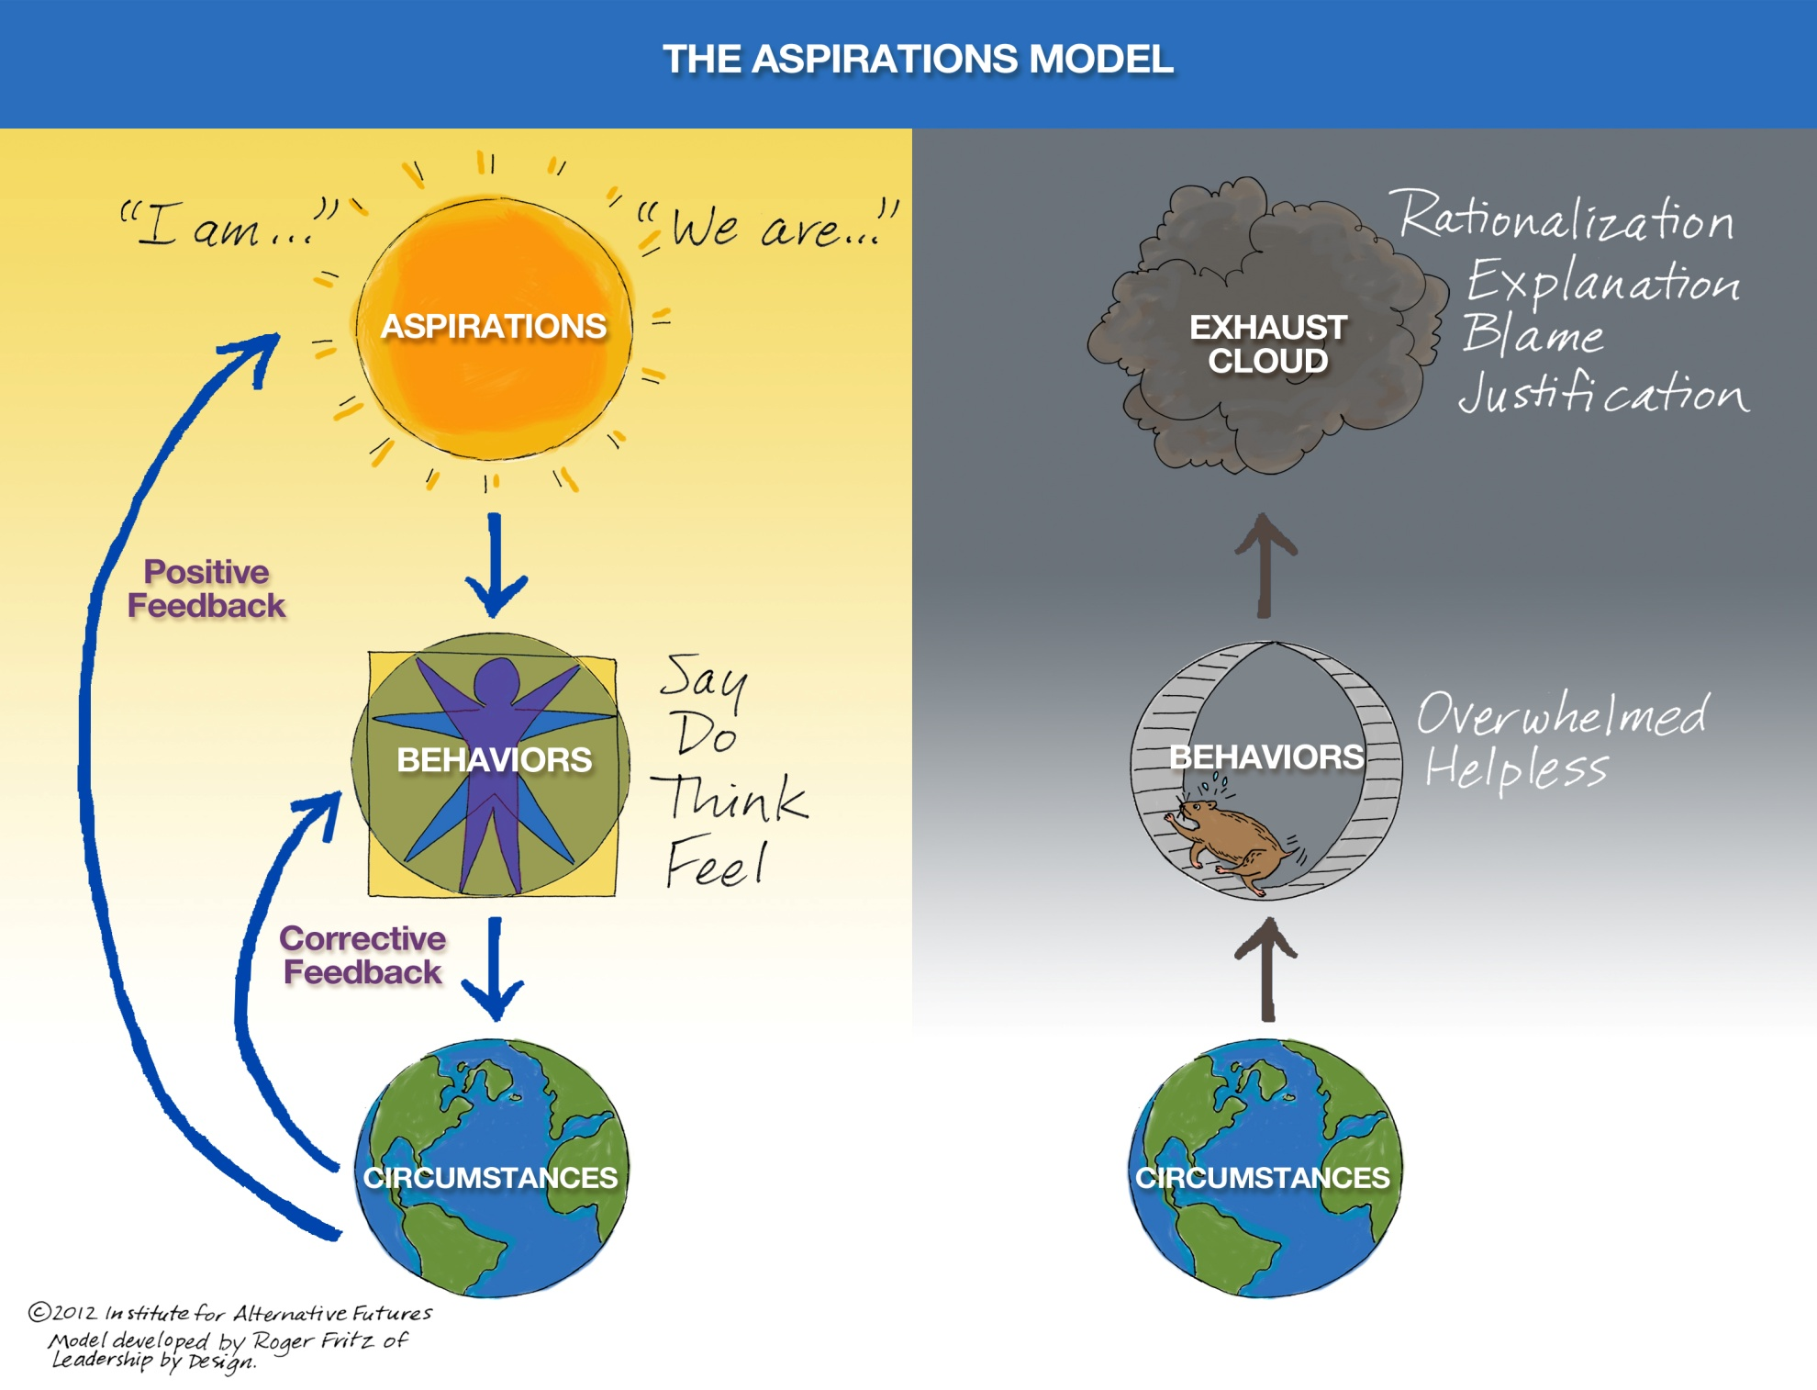

Slide 11
VHA Strategic Goals, 2013 - 2018
Provide Veterans personalized, proactive, and patient driven health care.
Incentivize measureable improvements in health outcomes.
Align resources to deliver sustained value to Veterans.

Slide 12
Personalized, Proactive, Patient-Driven
Personalized: tailoring a person’s healthcare to their individual characteristics, medical conditions, genes, circumstances, values, etc.
Proactive: using strategies that strengthen the person’s innate capacity for health and healing, such as mind-body approaches and nutritional strategies prior to surgery or chemotherapy.
Patient-driven: health care that is based in and driven by what really matters to the person in their life, and aligns their health care and goals accordingly. This requires that we change the conversation and start from a different place.

Slide 14
The WHAT Expands
A proactive approach to optimize health and healing addresses all aspects of life that can influence outcomes.
Many of the strategies that may be of benefit extend beyond what is conventionally addressed or provided by the health system.

Slide 15
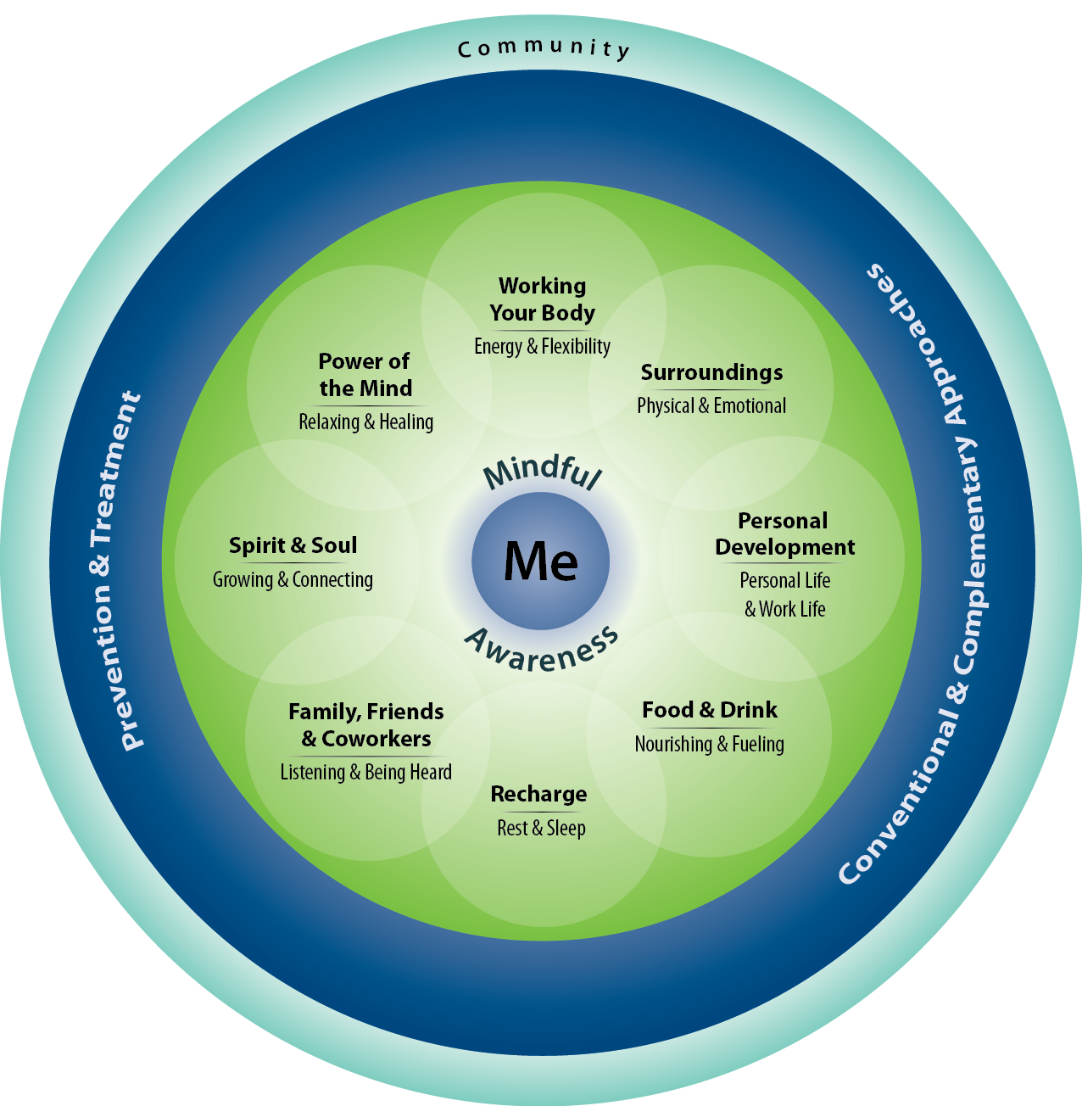

Slide 16
The HOW Expands
Mission for Life and Health
A Personalized Health Plan
Training and Skill building
Support to succeed
Mission for Life and Health
A Personalized Health Plan
Training and Skill building
Support to succeed
VETERANS HEALTH ADMINISTRATION

Slide 17
If we get the content of health care right, we will get the outcomes and the cost right
VETERANS HEALTH ADMINISTRATION

Slide 18
The Job of Our Office
Clearly define the destination
Provide the tools and support needed to make it happen
Help remove barriers to success

Slide 19
VETERANS HEALTH ADMINISTRATION

Slide 20
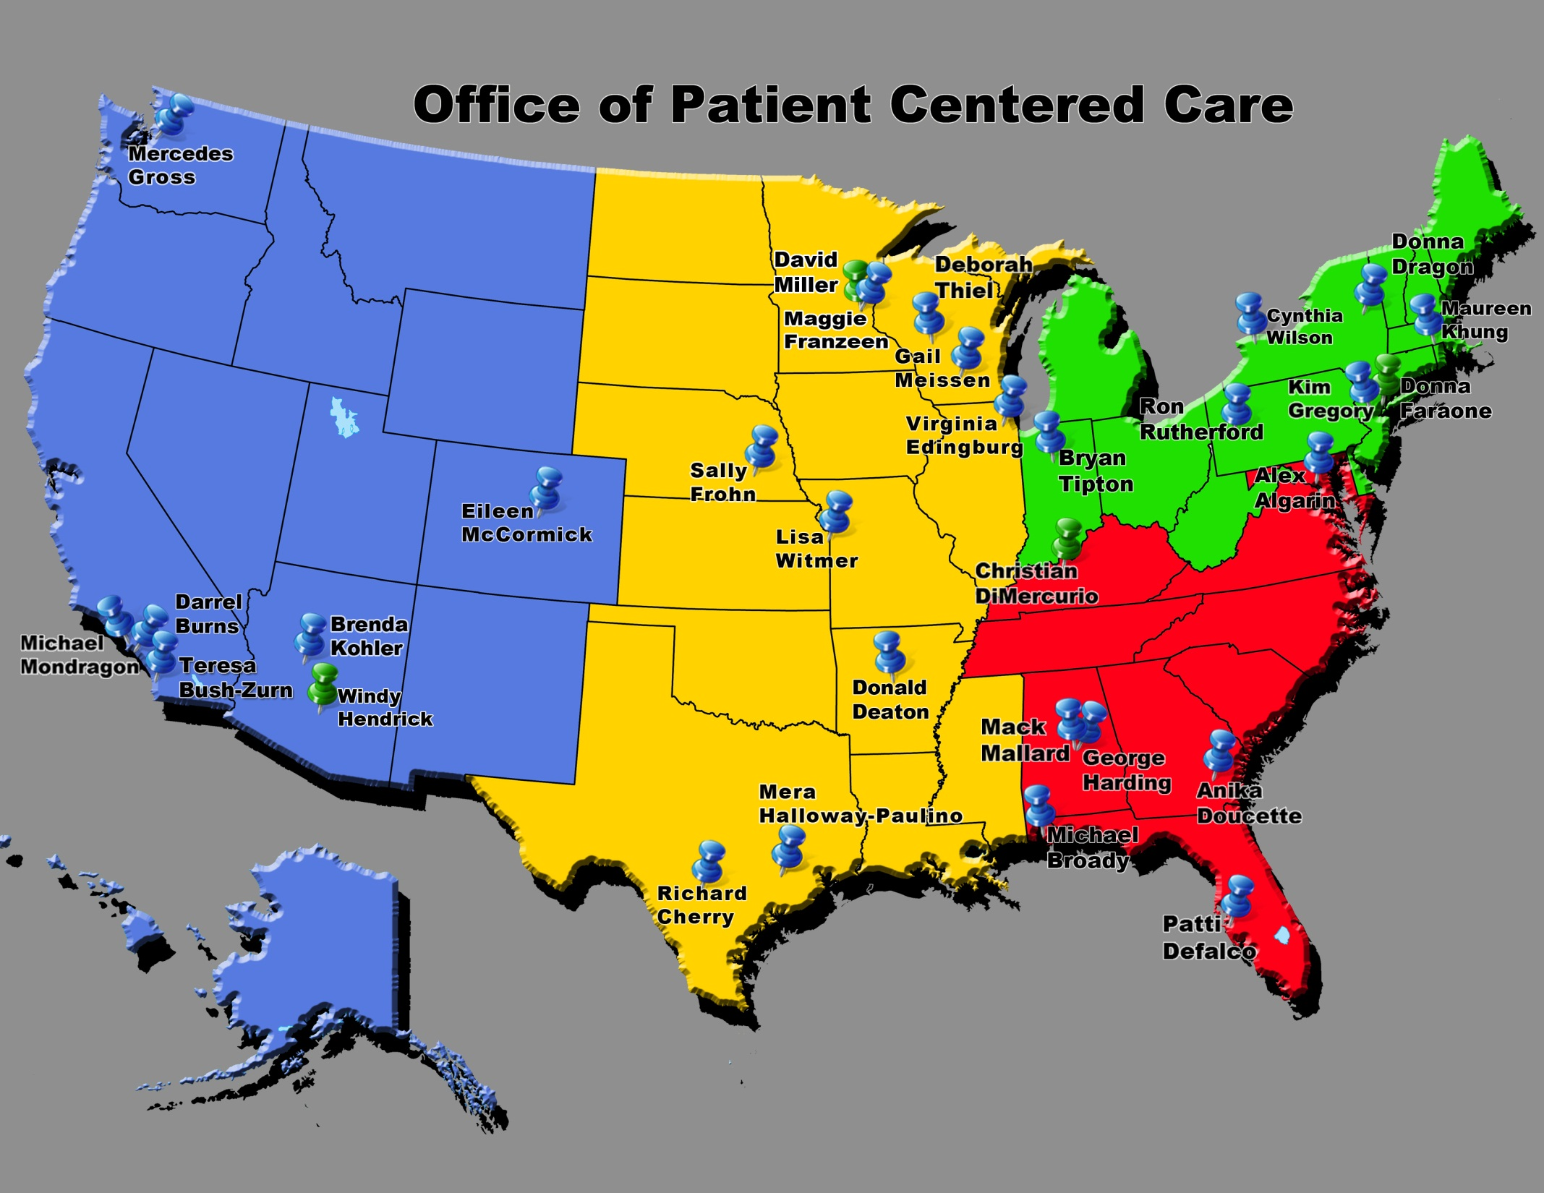

Slide 21
Clinical Experience and Innovation
VETERANS HEALTH ADMINISTRATION

Slide 22
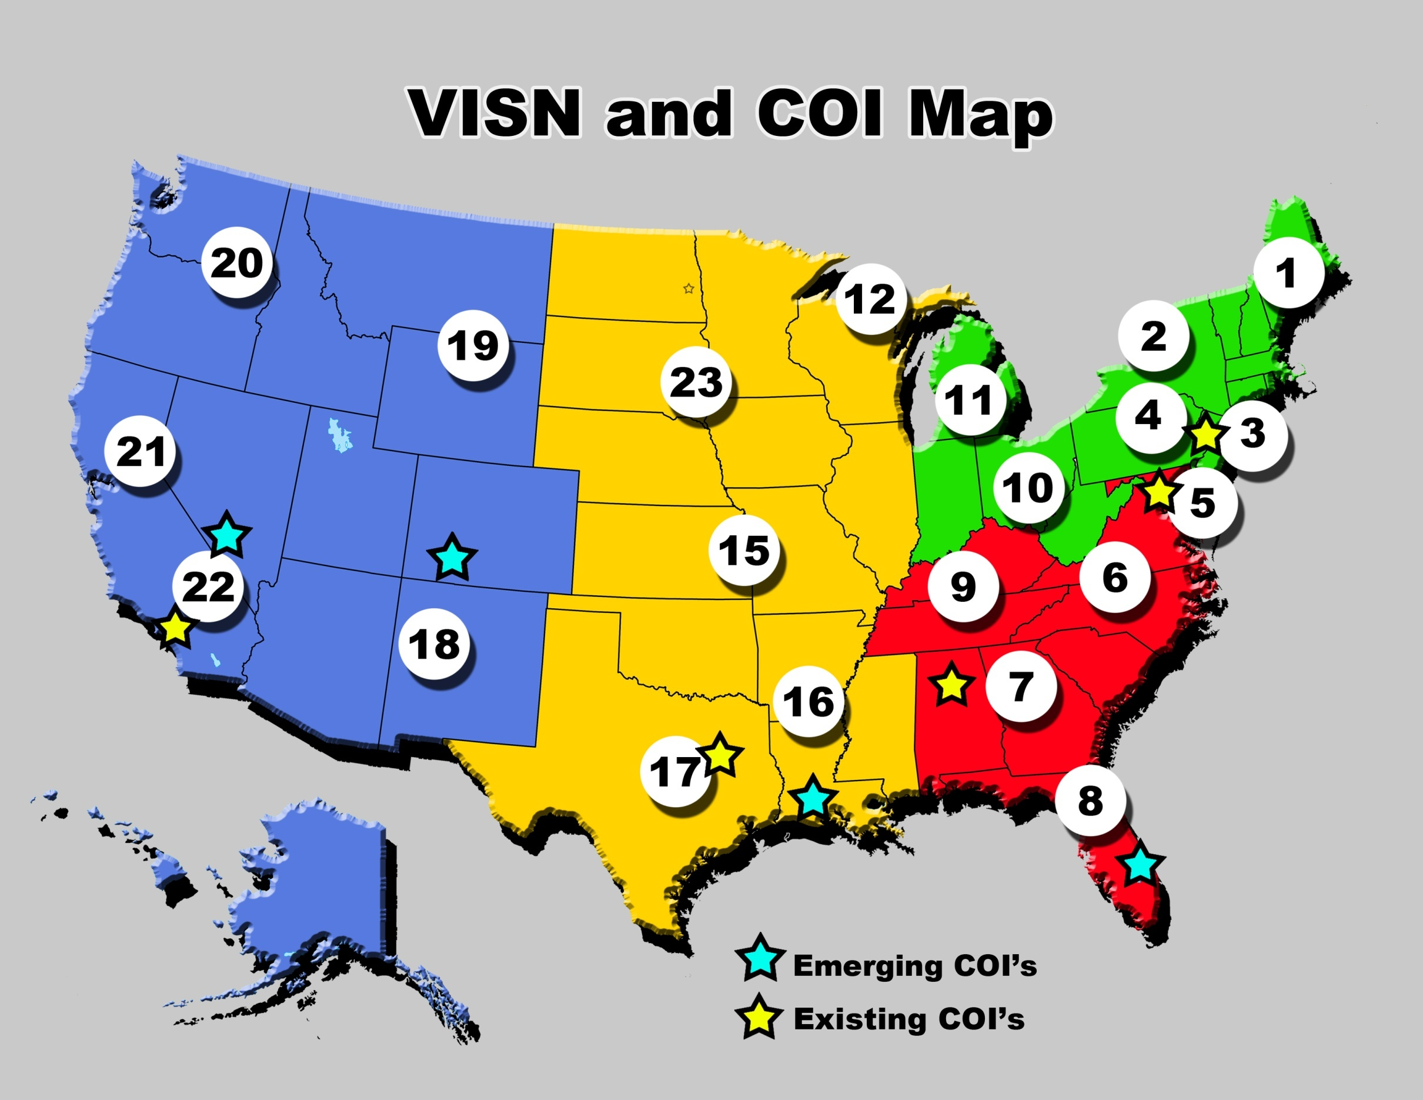
Notes:
Do we need A BETTER MAP FOR THE COIs…

Slide 23
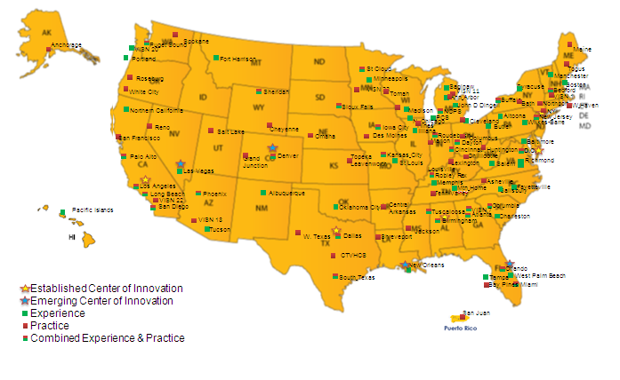
Patient Centered Care Innovation Grants
FY 10, 11, 12, 13 – Sites Funded for Innovation Grants * * Note that sites may have multiple projects funded

Slide 24
Outcomes and Analysis
VETERANS HEALTH ADMINISTRATION

Slide 25
QUERI
Established Centers of Innovation
Emerging Centers of Innovation
Personalized Health Planning Pilot Projects
Compendium of Research Related to Patient Centered Care
New Patient Centered Care Metrics
Evidence Mapping for Integrative Therapies
Personal Health Inventory Pilots – Conducted listening sessions with Veterans and Staff regarding PHI experience

Slide 26
Education and Training
VETERANS HEALTH ADMINISTRATION

Slide 27
Resources and Tools
OPCC&CT has developed a robust SharePoint site where resources and information can be utilized by the field:
http://vaww.infoshare.va.gov/sites/OPCC/default.aspx
Located within the OPCC&CT SharePoint site are resources designed to assist the field with having a framework (graphical models) for shifting from VA’s current medical model to care that is personalized, proactive and patient-driven (Clinical Toolkits) :
Clinical Toolkits ( eg Personal Health Inventory, Personal Health Plan Staff Guide)
Communications
Graphical Models
Presentations
Videos
Photos

Slide 28
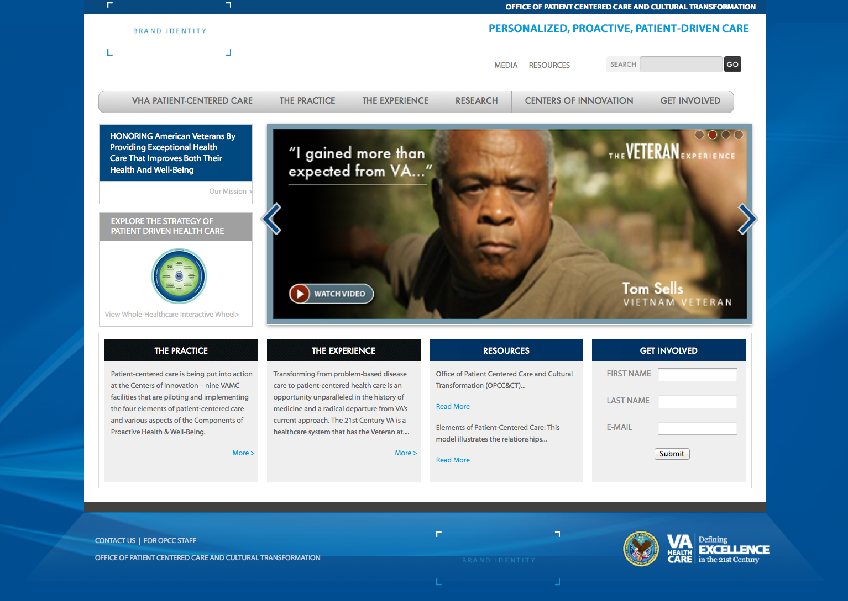
OPCC&CT Web Presence
http://www.youtube.com/watch?v=MoSNShP-Yqc

Slide 29
Patient Centered Education
National Integration Team
Current State Report (>30 interviews)
Develop comprehensive curriculum
Patient Centered Clinical Care Foundation Program ( general audience) – Completed 3 separate sessions resulting in 80 trainers including 48 facility level, 10 PACT COE, and PCC FIT partners
Patient Centered Clinical Care Health Coaching (PHP health coaching) – Dallas, TX training occurred
Patient Centered Clinical Care (clinical staff core competencies)
Develop aligned Veteran curriculum

Slide 30
Deployment across VHA
VETERANS HEALTH ADMINISTRATION

Slide 31
VHA Wide Field Based Implementation
Overarching Field Strategy:
Launch and/or Support PCC Cultural Transformation process with facilities
Foster Innovation and Dissemination of Practices
Provide a robust array of field Supportive Services to meet evolving needs
We are currently engaged with >43% of facilities

Slide 32
Executive Leadership Readiness , Commitment and Practice Structures/Integration
Information Sessions
Organizational Assessments
Leadership Engagement Sessions
Staff Engagement Sessions and Facilitator Workshop
Duration: 1 day (1/2 day ERLC, 1/2 day interviews)
Audience: Quadrad and POC
Goal: To help senior leaders create both an individual and organizational vision of PCC, and to identify individual and organizational commitments to bring their vision to reality. Then, to collect information to enrich and inform future steps in this cycle.
Setting: Senior leadership conference room
Equipment: Projector, screen, speakers
Duration: 1 hr. sessions repeated during 2 days
Audience: All Staff, Volunteers and Veterans
Goal: To introduce the VHA model of Patient-Centered Care to as many Staff, Volunteers, and Veterans as possible; to learn more about PCC initiatives already underway, to share other examples of PCC to aspire to, and to inspire staff to get involved.
Setting: Auditorium or other large space that can hold 50-100 people per session is ideal
Equipment: Projector, screen, microphone & speakers
Audience: Various stakeholder groups
Goal: To assist the facility and its leaders in understanding their current status when it comes to providing PCC to its Veterans, and a culture of caring for visitors, volunteers, staff and providers. Facilitated listening sessions are held with various constituencies and a report is provided.
Setting: Senior leadership conference room (opening & closing), various conference rooms that will seat 15-20 people
Equipment: Digital recorder (to be provided by FIT team)
Duration: 3-4 days
Duration: 1 day
Audience: Leadership at all levels (max of 40 ppl/session)
Goal: To immerse leaders in a learning process that defines leading in a PCC environment and to prepare leaders to lead the initiative by engaging them as champions for the cause.
Setting: Large conference or meeting room (off-site preferred)
Equipment: Projector, screen, speakers, microphone
Duration: 1 day Engagement Session and 2 day Facilitator Workshop
Goal: To create awareness of PCC and unity among staff members by sharing the patient perspective and inspiring staff to engage in the journey as facilitators.
Setting: Large meeting room (offsite preferred) with moveable tables & chairs, access to nature and/or a welcoming, healing environment.
Equipment: Projector, screen, speakers
Audience: Select staff from all levels, then staff chosen to facilitate continue on for the Workshop

Slide 33
Current Field Engagements
Boston VAMC - Information Sessions
VA New York Health Care Systems - Organizational Assessment
Fresno VAMC - Leadership and Information Sessions
Jesse Brown VAMC – Leadership and Staff Engagement Sessions
Lexington VAMC - Staff Engagement Sessions
Huntington VAMC - Leadership Engagement Sessions
VISN 8 PCC Coordinator training

Slide 34
Field Engagements Continued
Poplar bluff, MO – Leadership Engagement Sessions
Tomah, WI – Organizational Assessment
Wilkes Barre visit to NJ Center of Innovation
Erie, PA – Information Sessions
White River Junction, VT – Executive Leadership Session
Bedford, MA – Organizational Assessment
Charleston, SC – Organizational Assessment
Miami, FL – Staff Engagement Sessions
San Juan, PR – Staff and Leadership Engagement Sessions

Slide 35
Consultation, Resources and Services
Meeting Organizations Where They Are
VISN OPCC&CT Liaison
Regional Planning and Development
Communities of Practice
Tool Boxes and Tools
Provision of On-Line, “Real Time” and Face to Face Education and Training
Collection, Sharing and Dissemination of Practices
Provision of Focused Consultative Services “Deep Dive” Based on Strategic Priorities, Pilots, Grants, etc.
“path of transformation”

Slide 36
Veterans committed their lives, health, and well-being to Mission Success in defense of our country.
VETERANS HEALTH ADMINISTRATION

Slide 37
Now, we can help them be mission ready for their lives, optimizing their health in service of what matters to them.
How Will We Identify Success?
When Veterans achieve outcomes they never even imagined.
VETERANS HEALTH ADMINISTRATION

